Slide 2

DESIGN A SERVING
MOBILE ROBOT FOR RESTAURANT
Name: Tran Minh Duc – 20181875
Tran Tuan Minh – 20181906
Ly Duc Trung – 20181930
Supervisor: Le Minh Thuy

Slide 3
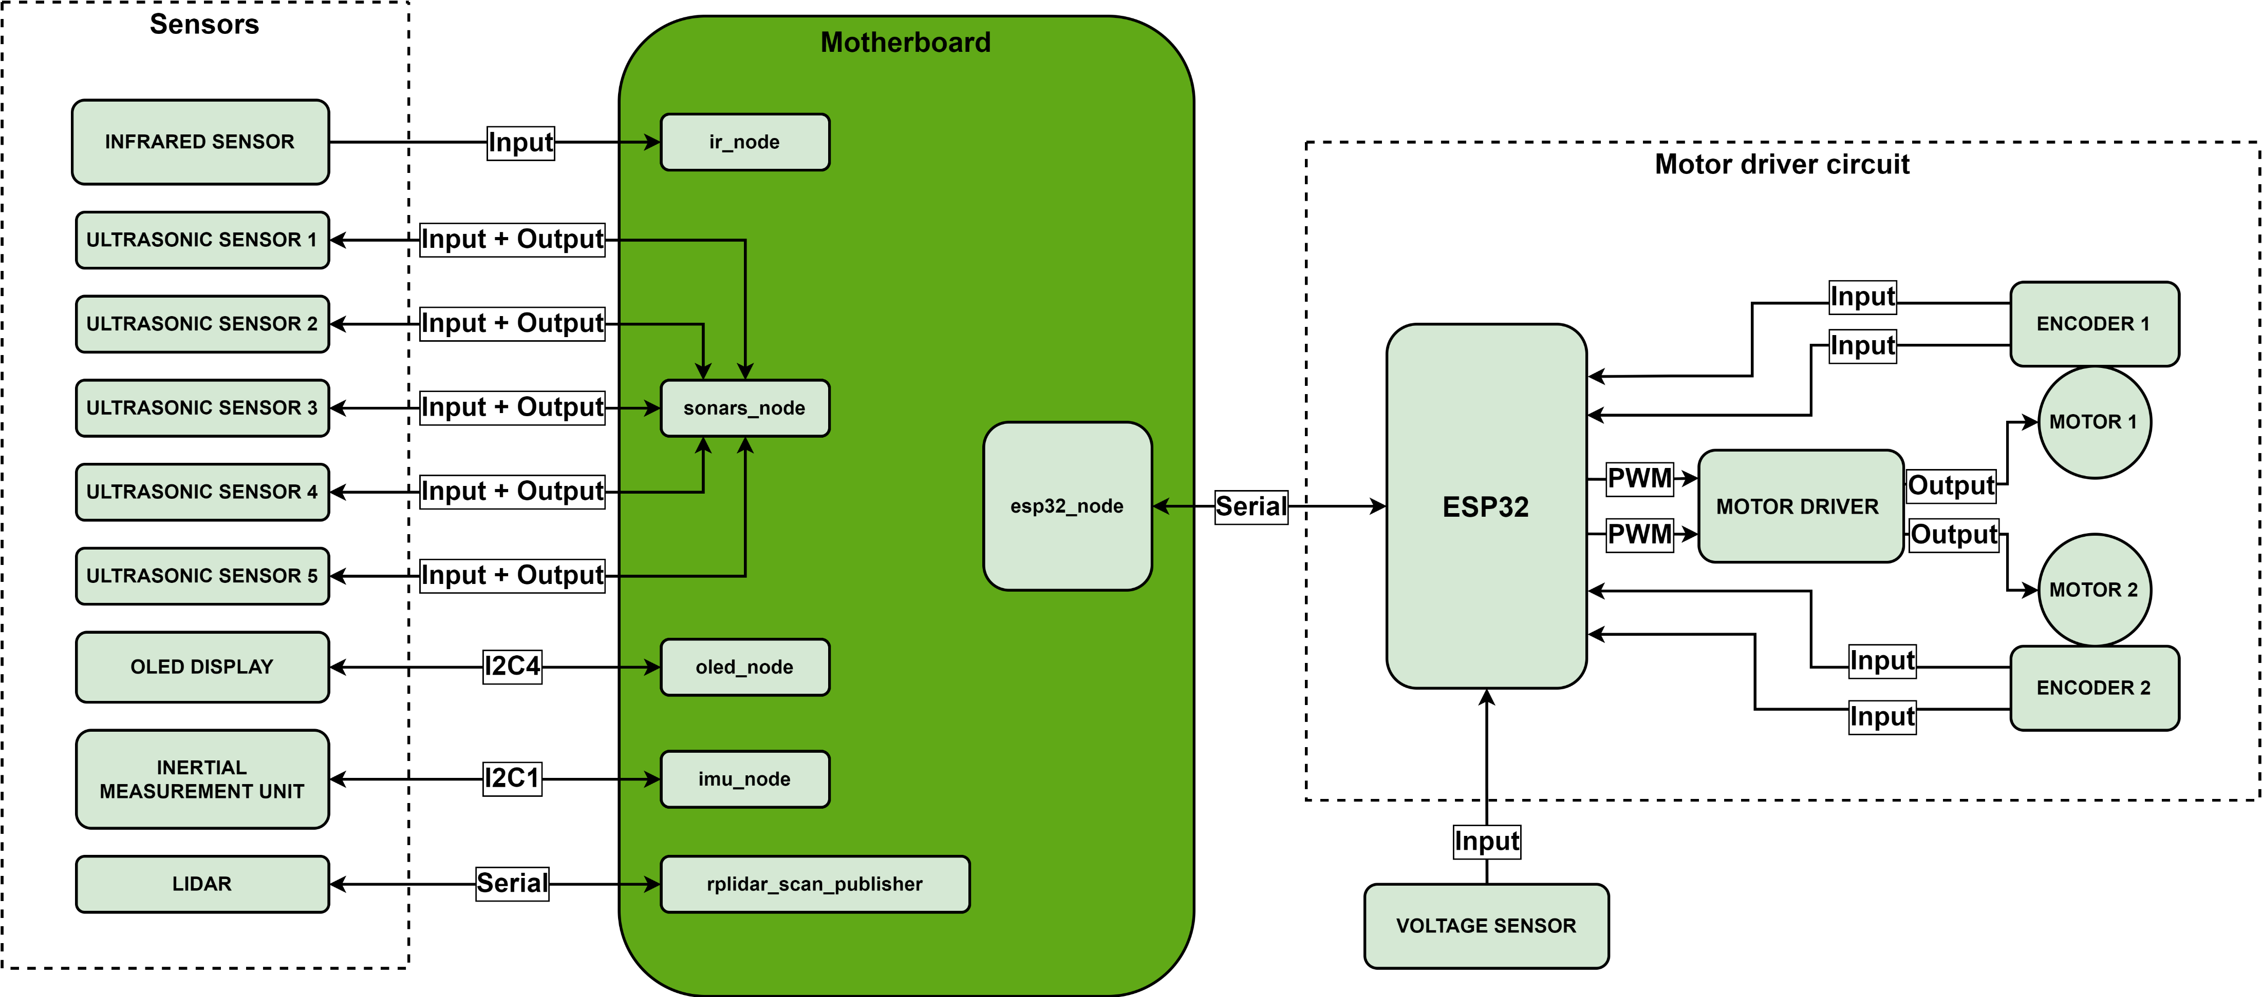
x. FIRMWARE ARCHITECTURE

Slide 4
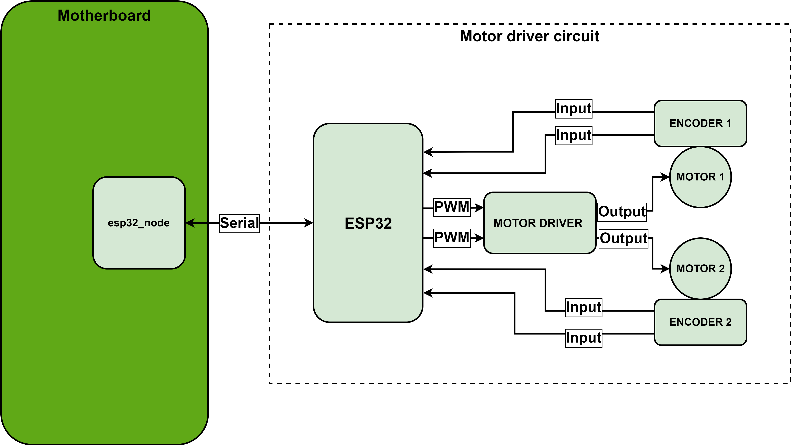
x. MOTOR DRIVER CIRCUIT

Slide 5
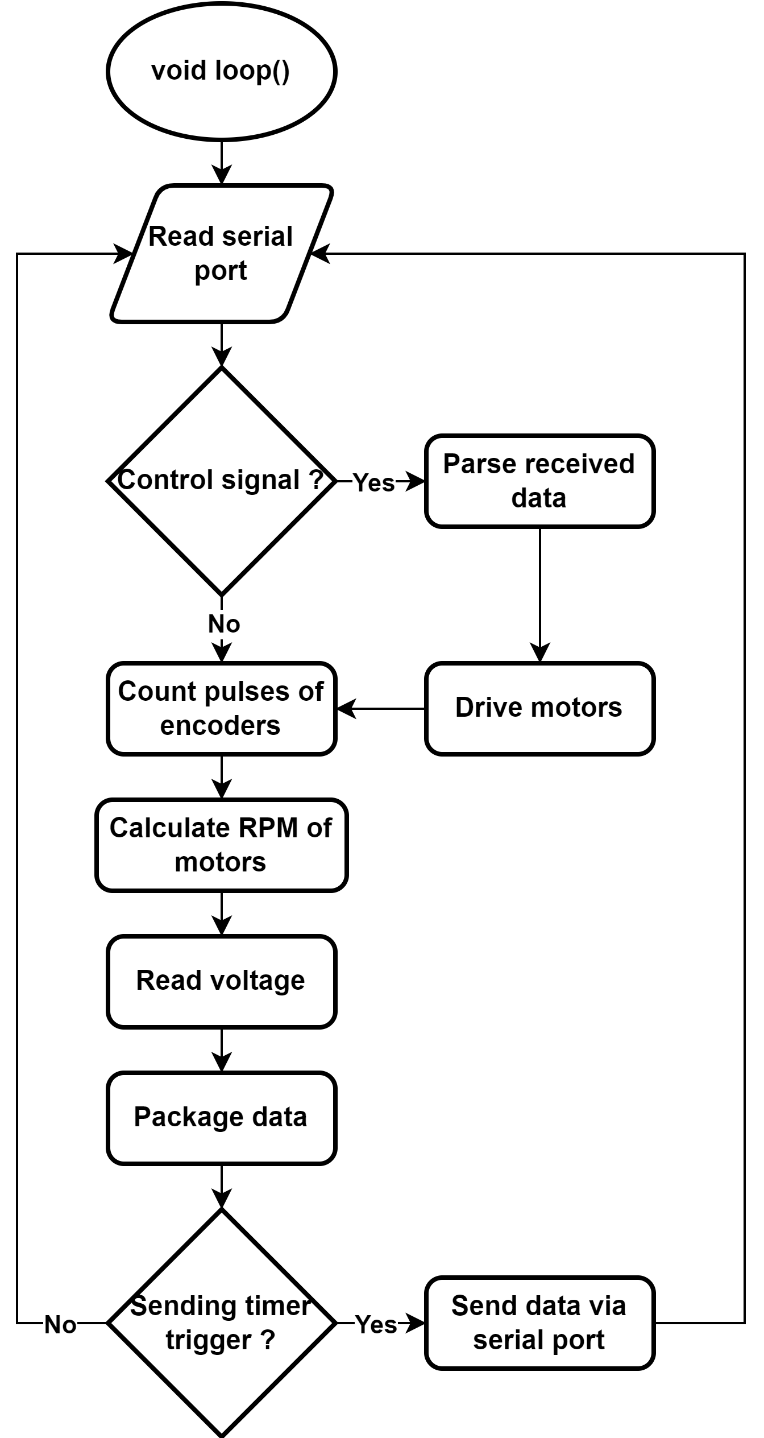
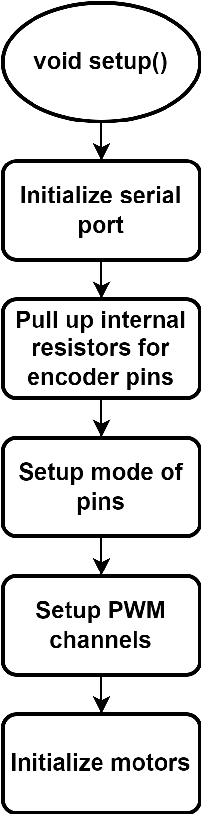
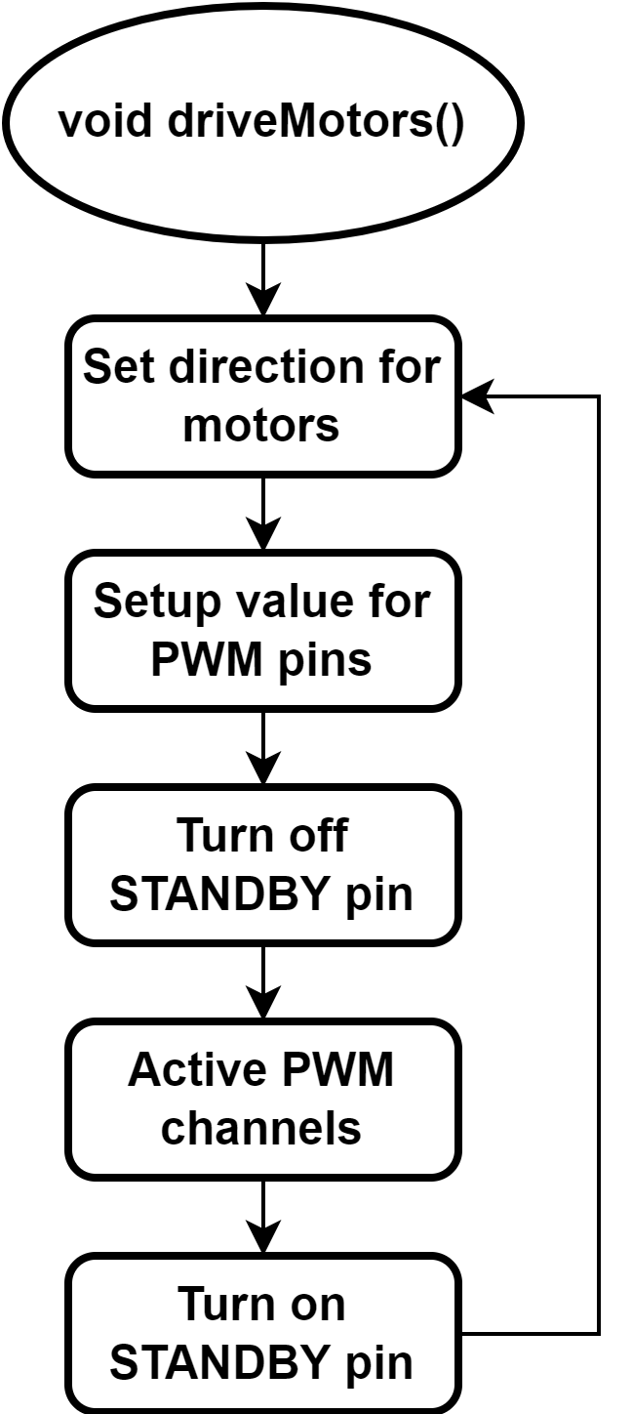
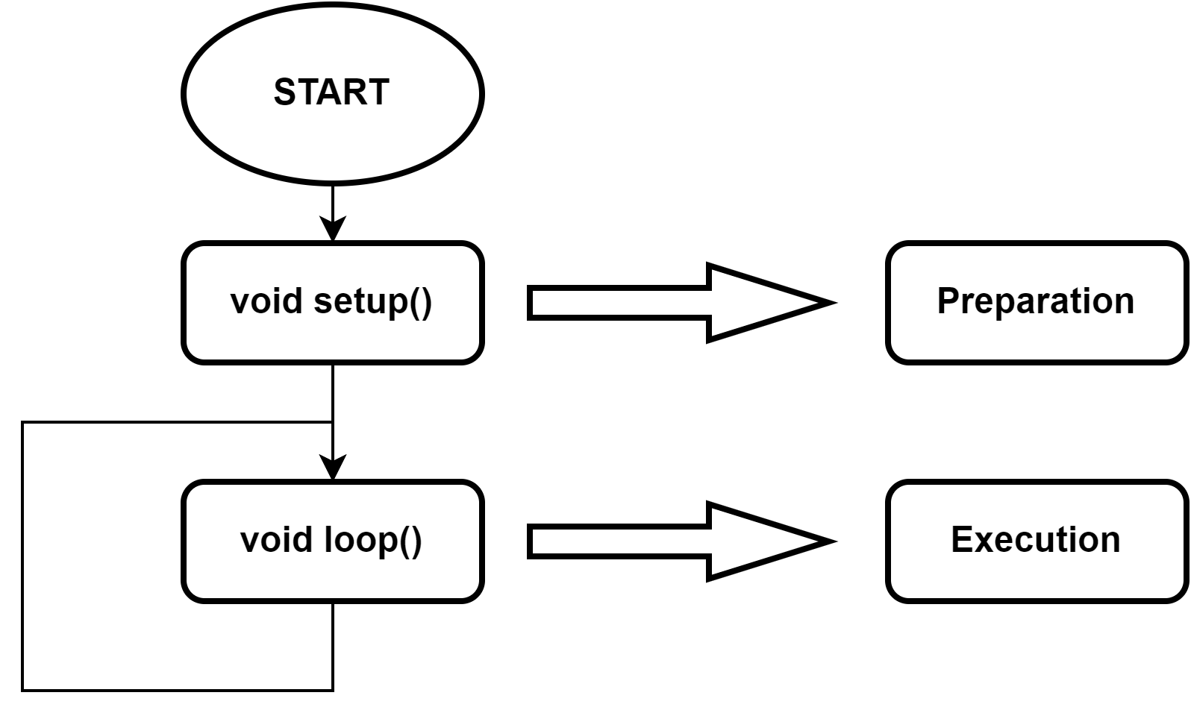
x. MOTOR DRIVER CIRCUIT – ESP32 MCU

Slide 6
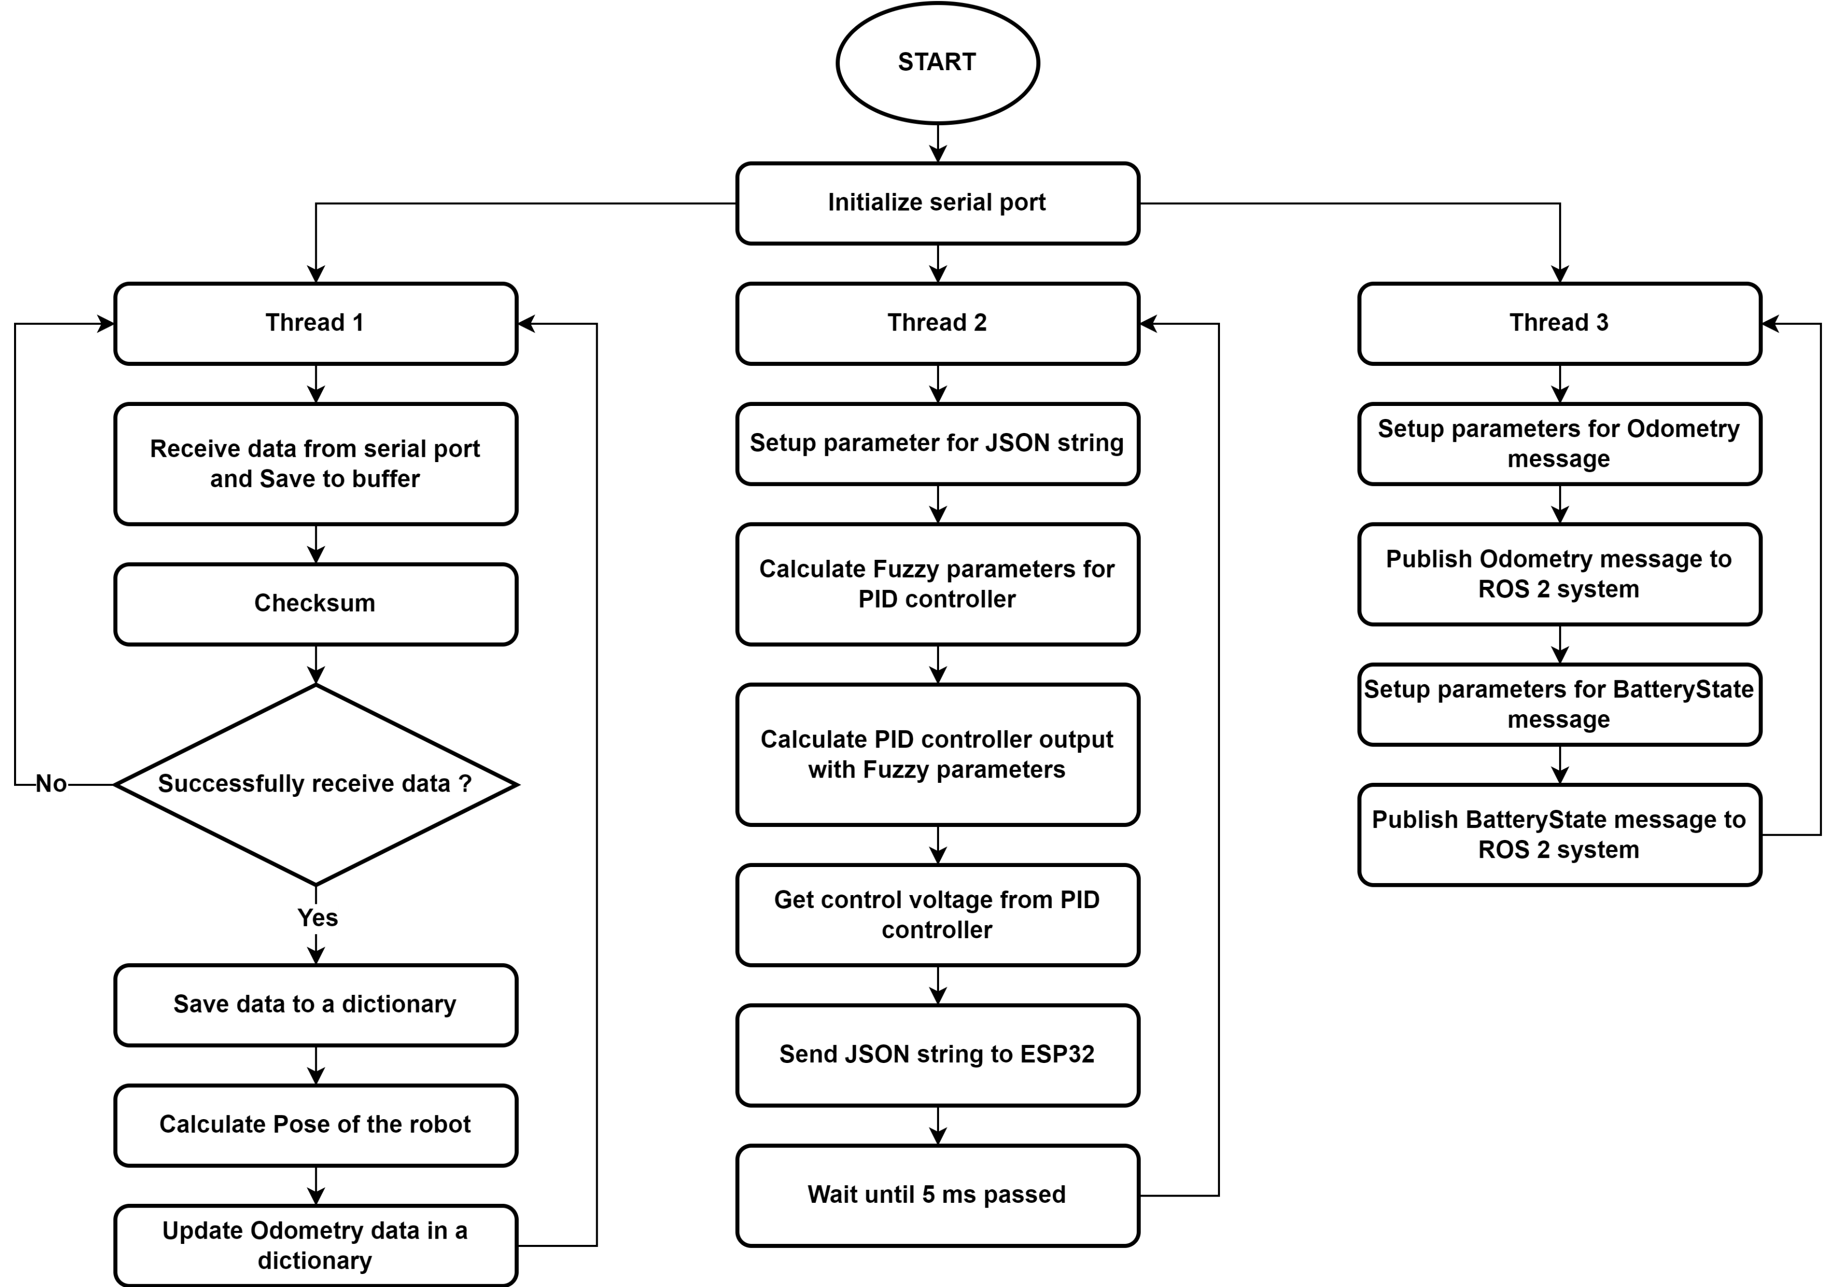
x. MOTOR DRIVER CIRCUIT – RASPBERRY PI 4

Slide 7
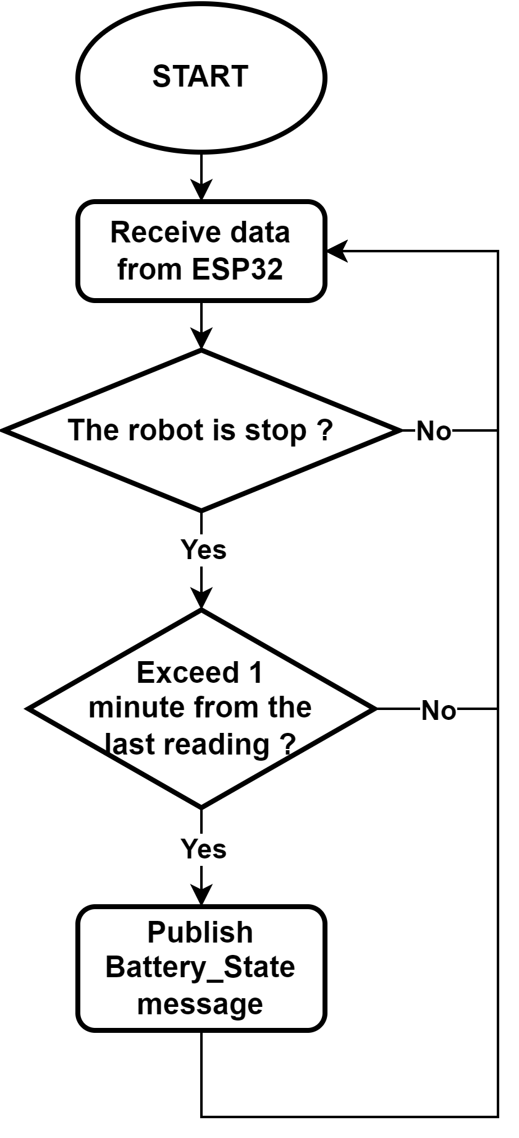
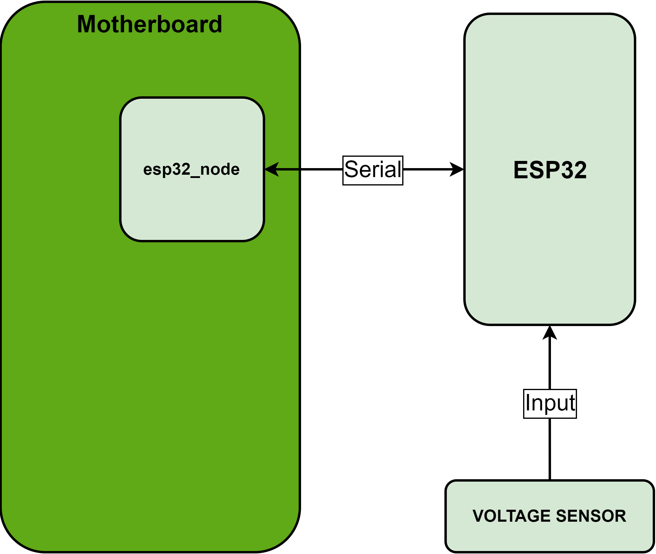
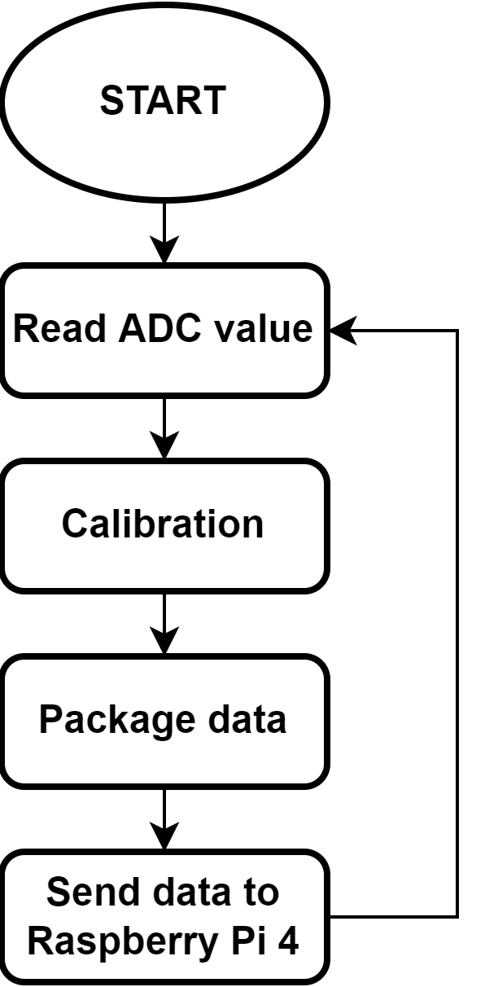
x. VOLTAGE SENSOR
Firmware for ESP32 microcontroller
Firmware for Raspberry Pi 4

Slide 8
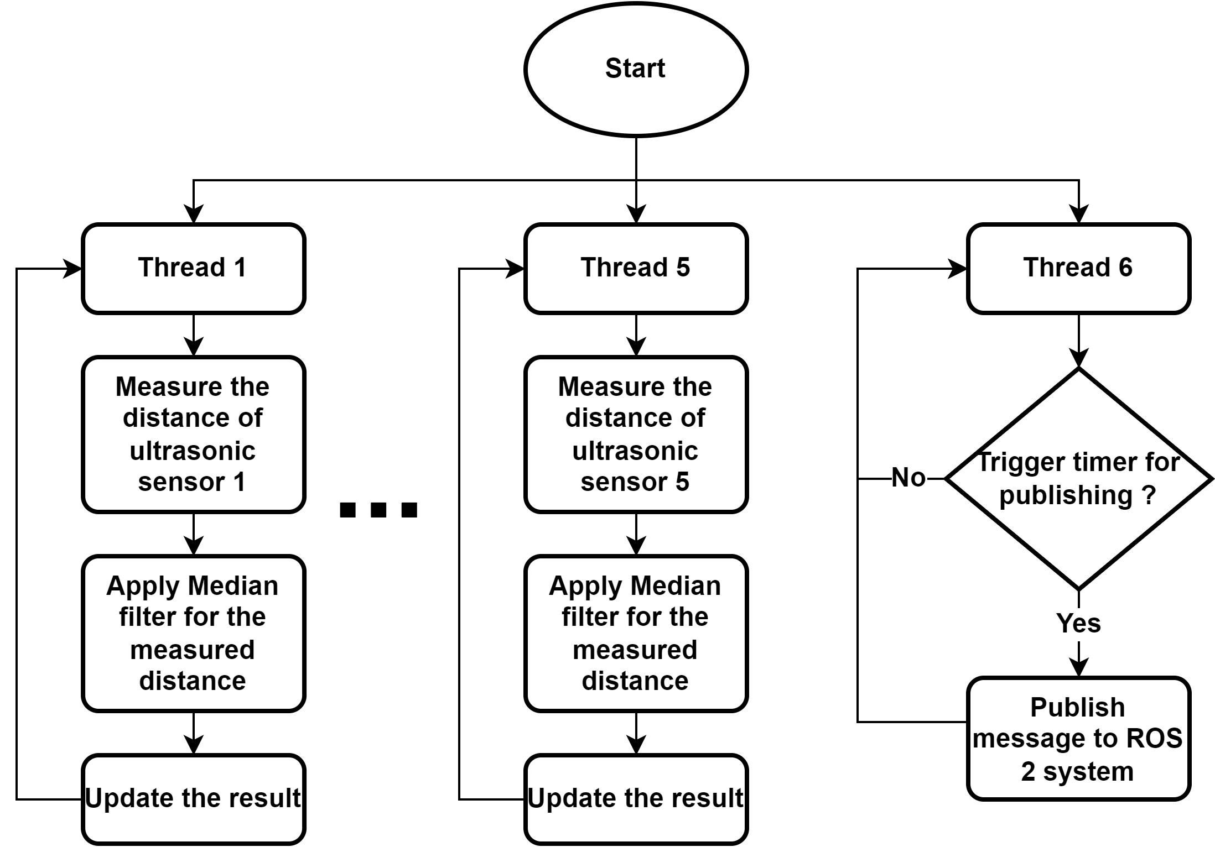
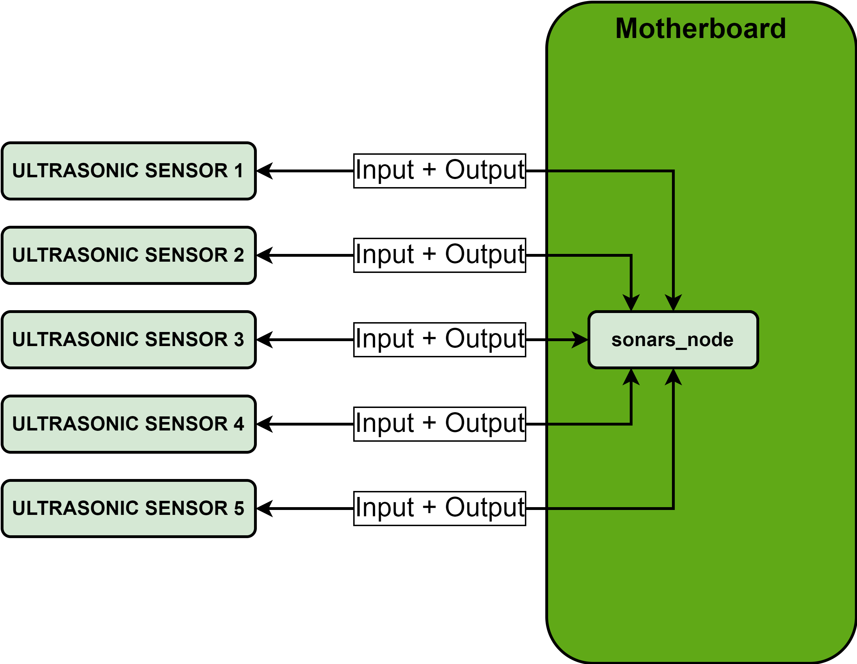
x. ULTRASONIC SENSORS

Slide 9
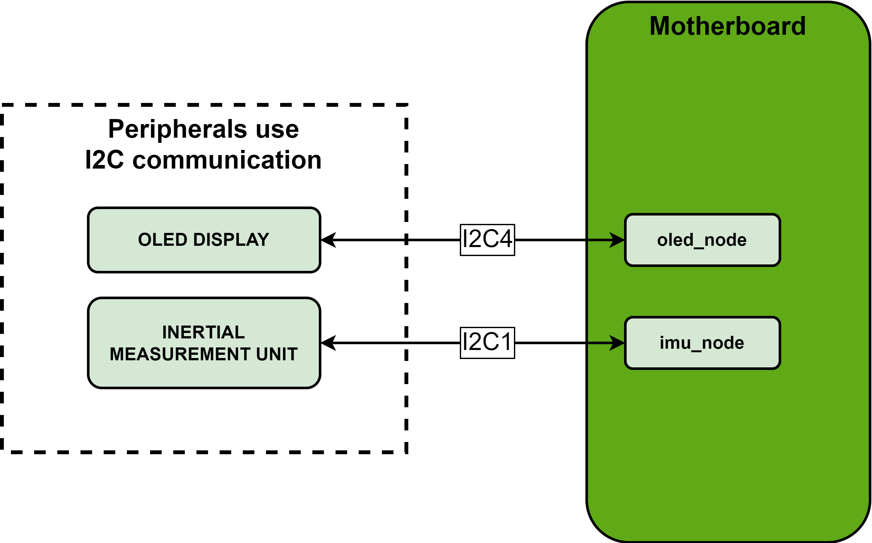
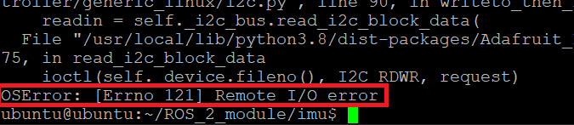
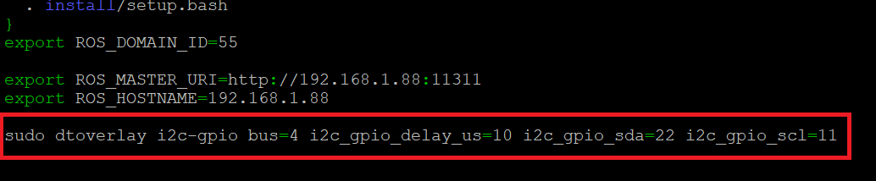
x. I2C BUSES – PROBLEM AND SOLUTION
Problem of I2C buses
Solution of I2C buses

Slide 10
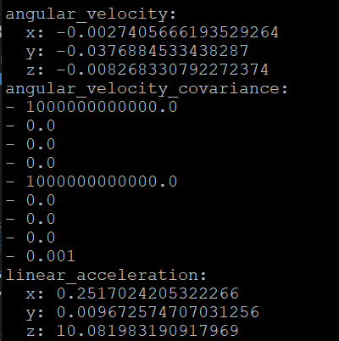
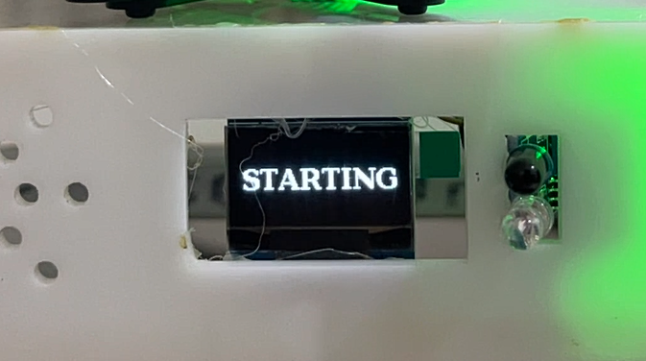
x. I2C BUSES FIXED RESULT
OLED display operates normally
IMU MPU-6050 operates normally

Slide 11
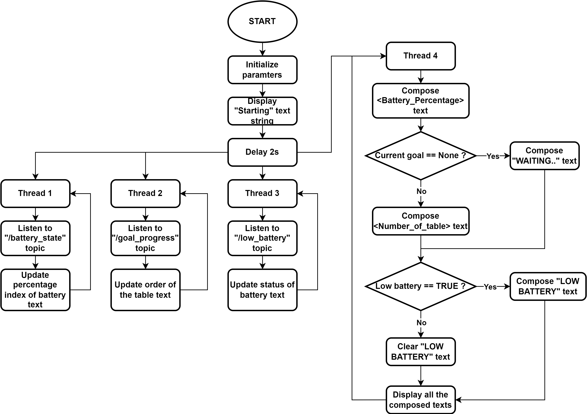
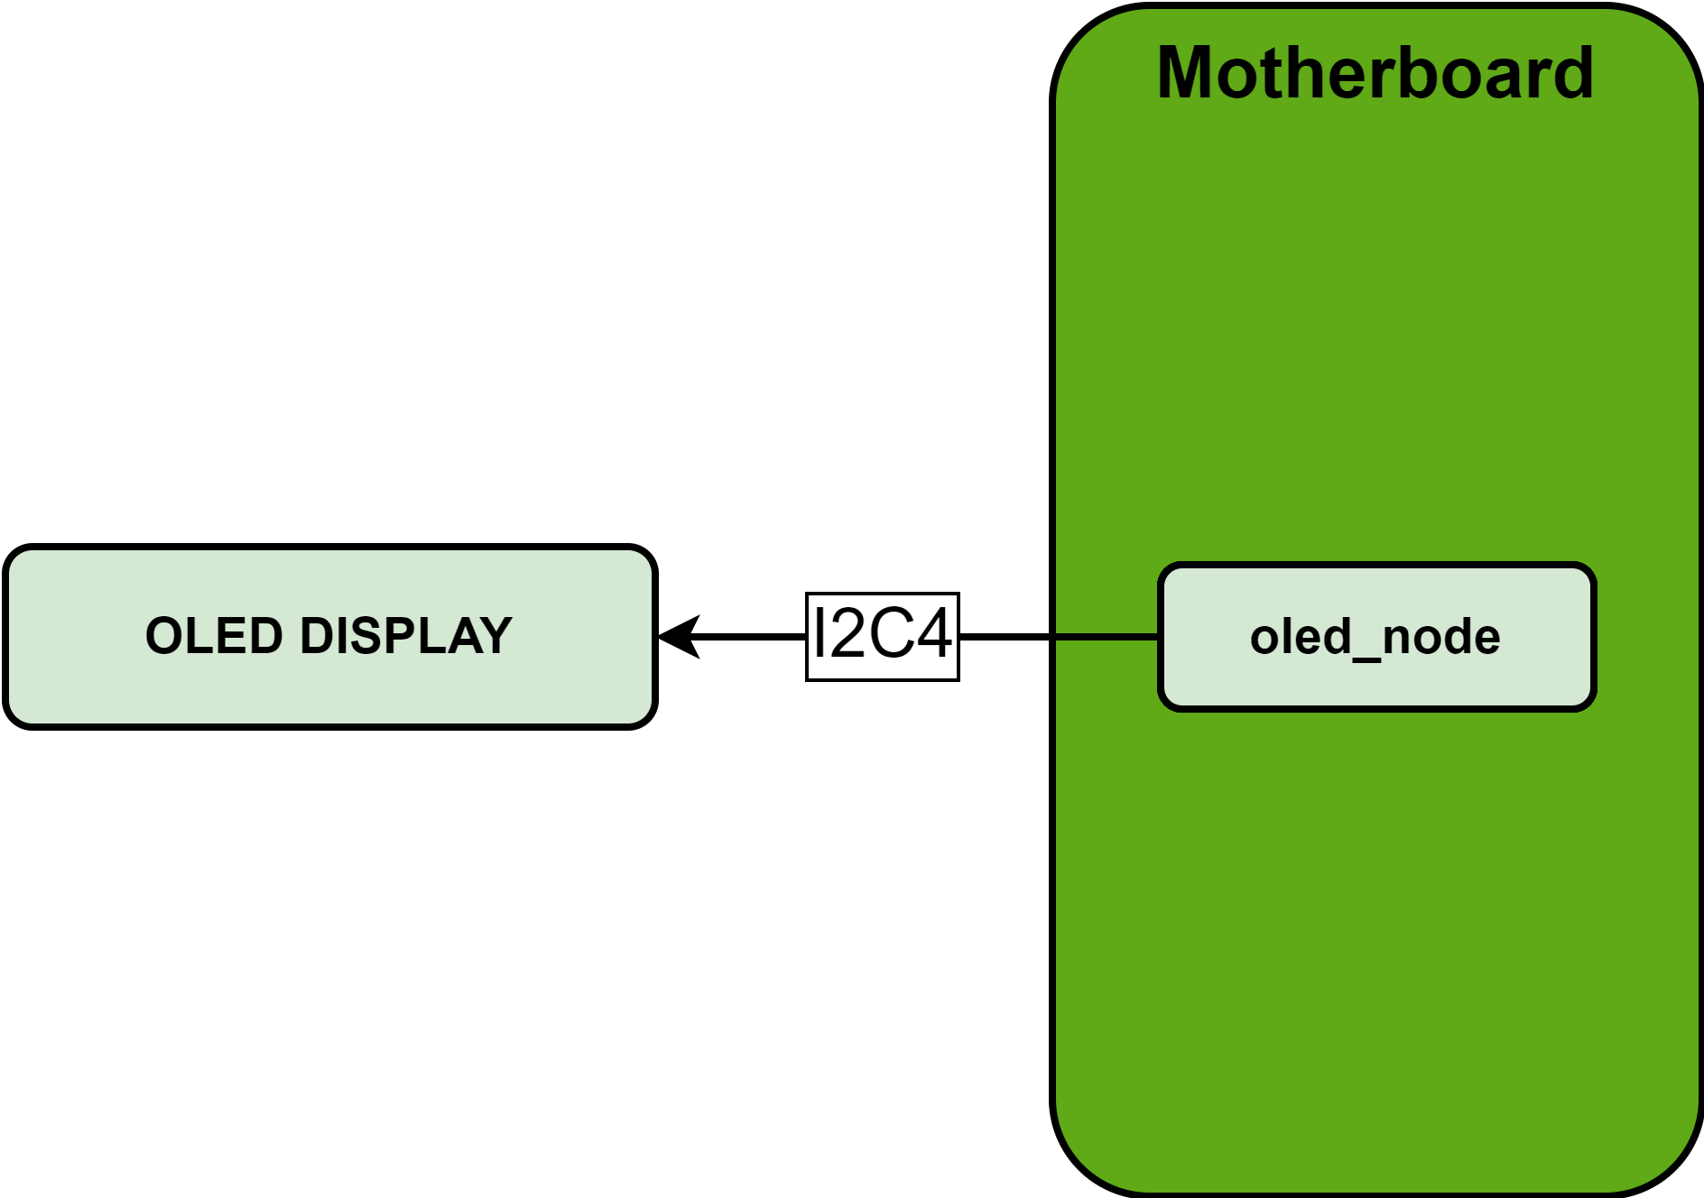
x. OLED DISLPAY

Slide 12
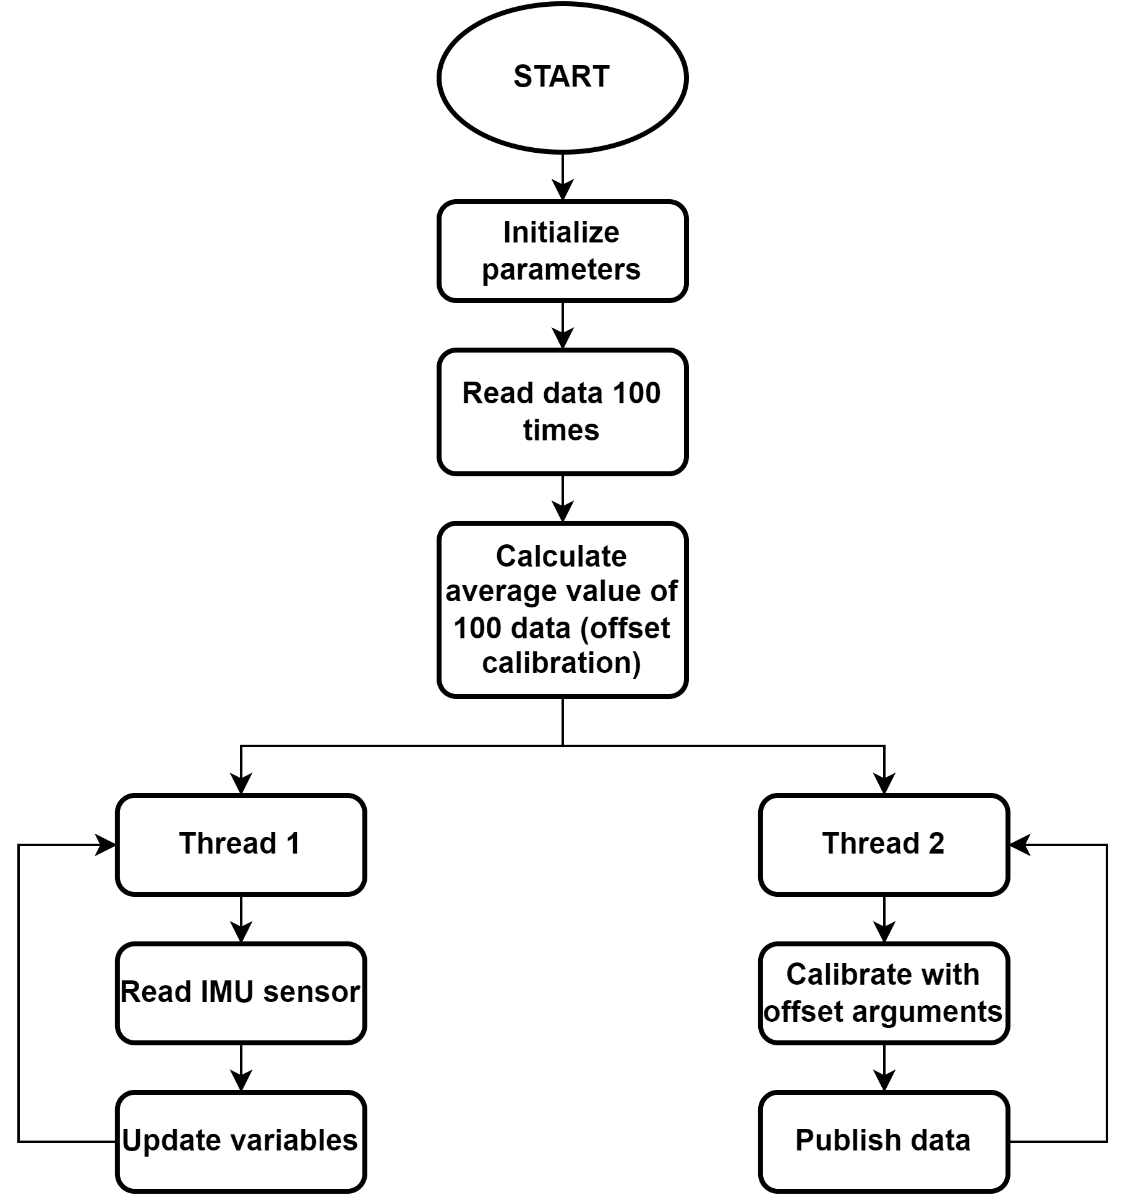
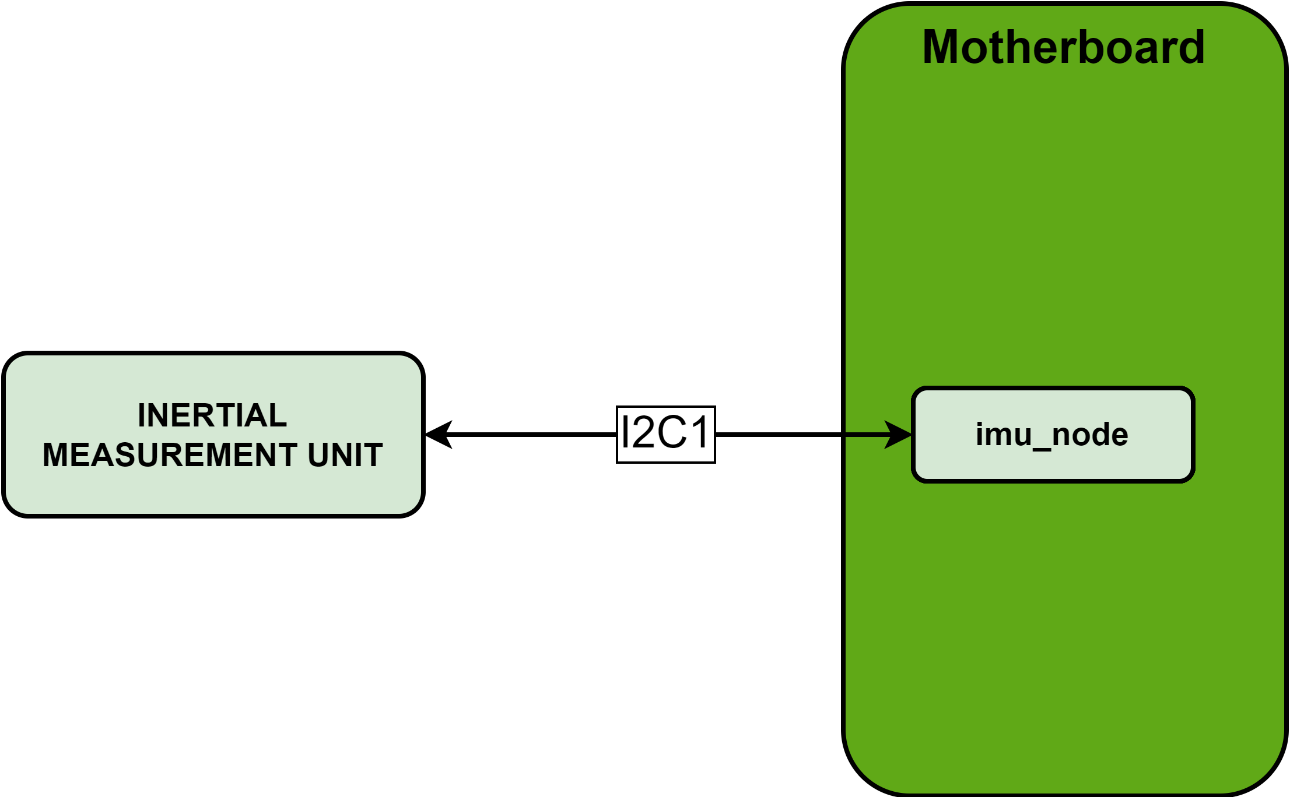
x. INERTIAL MEASUREMENT UNIT SENSOR

Slide 13
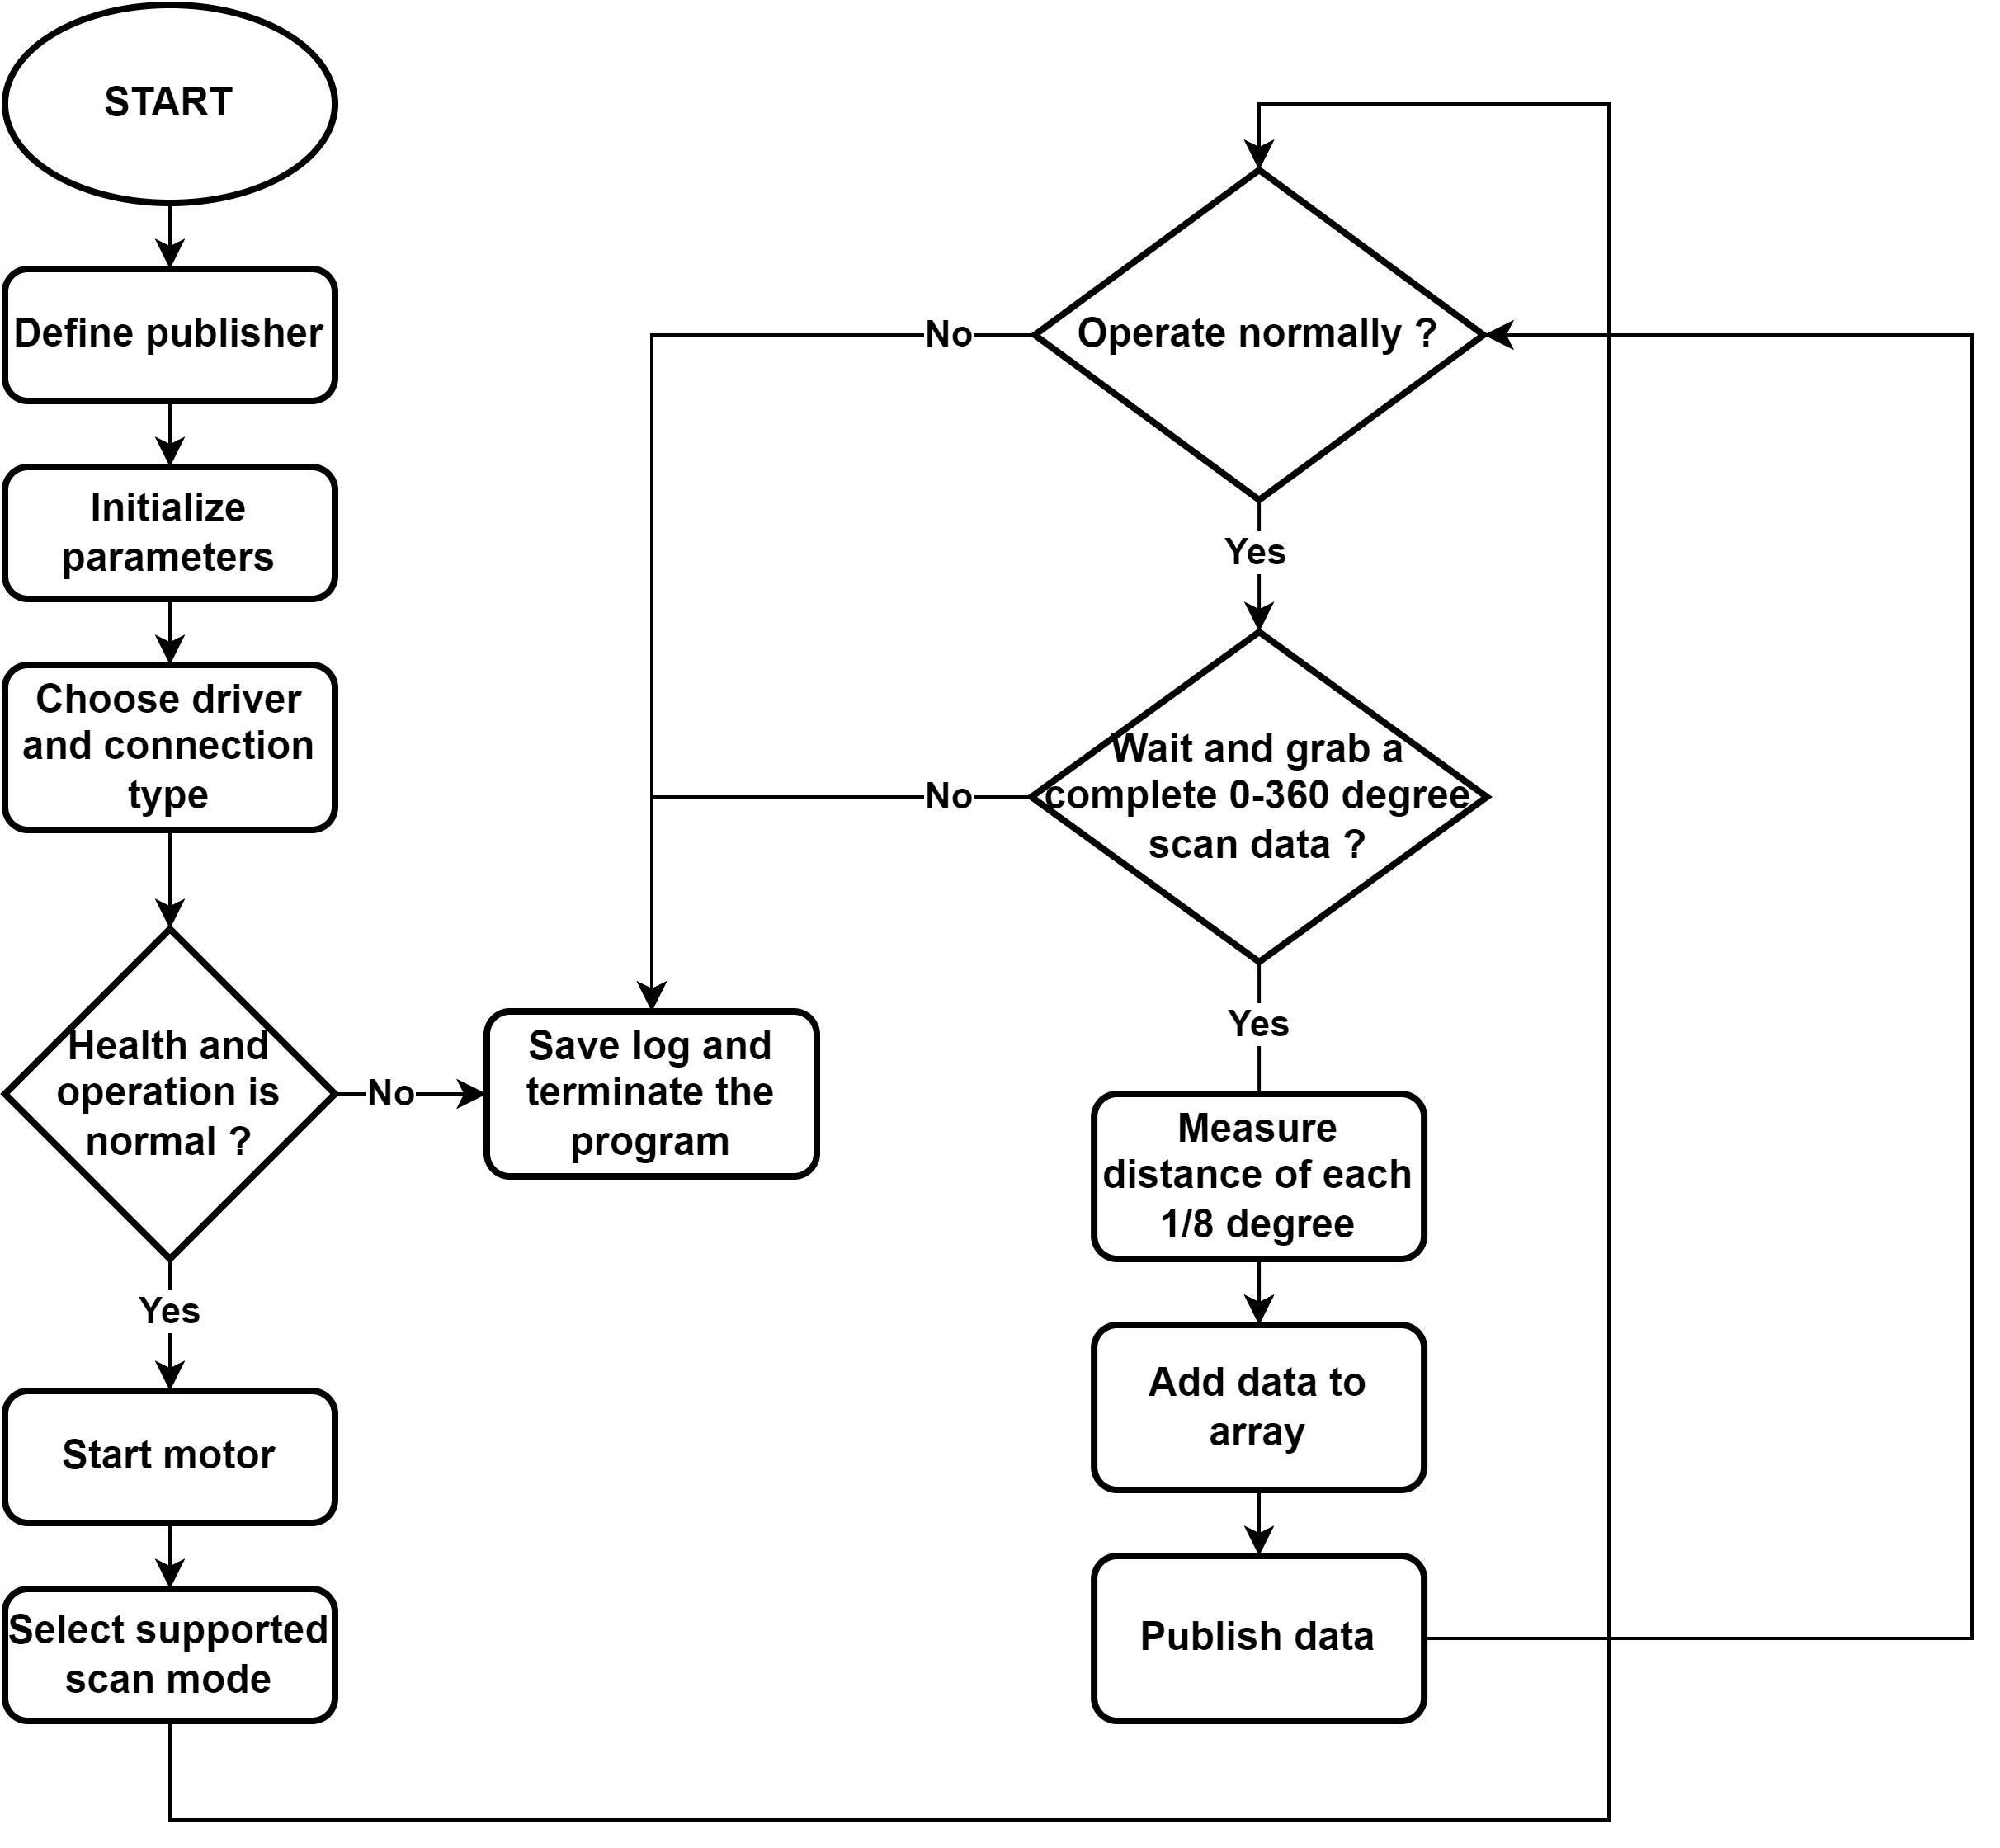
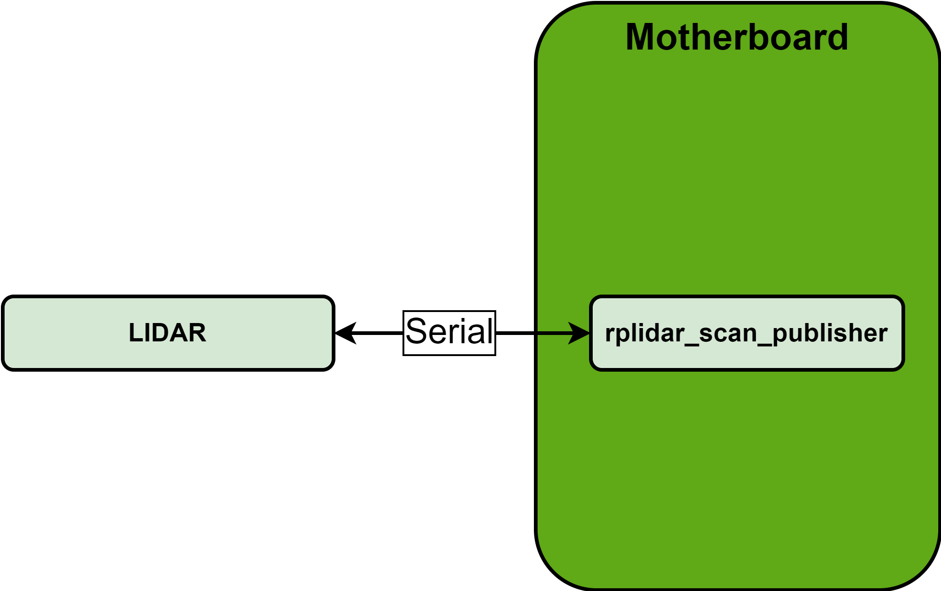
x. LIDAR SENSOR

Slide 14
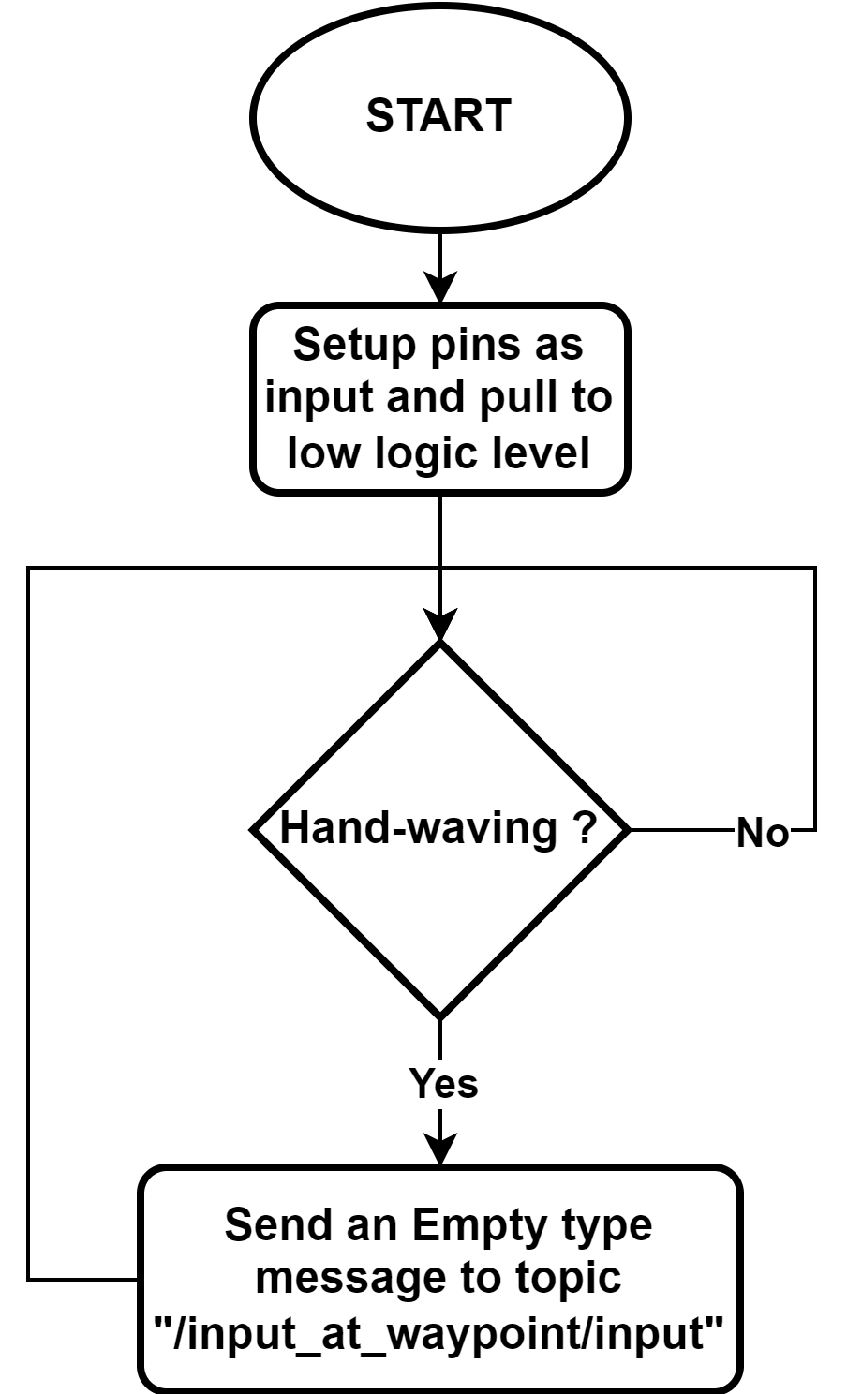
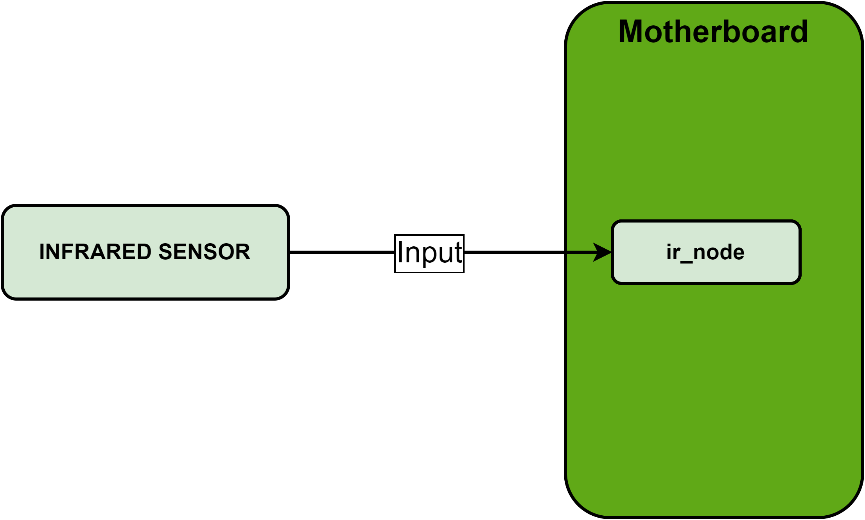
x. INFRARED SENSOR

Slide 15
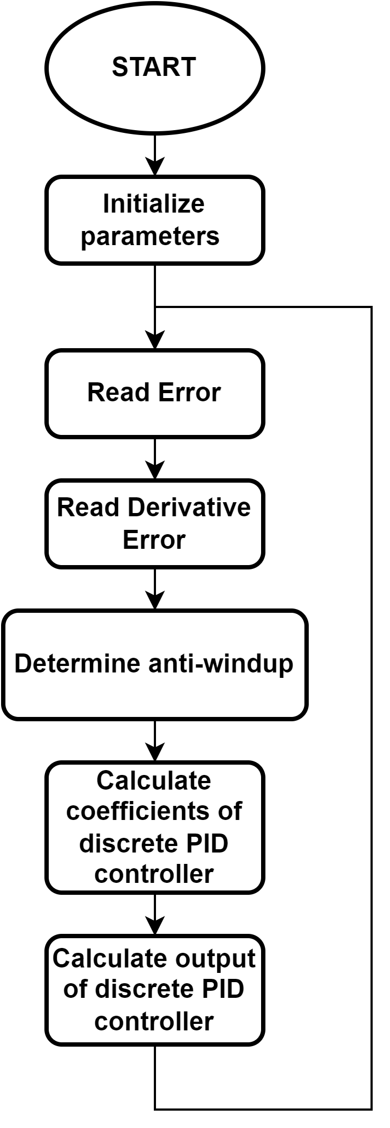
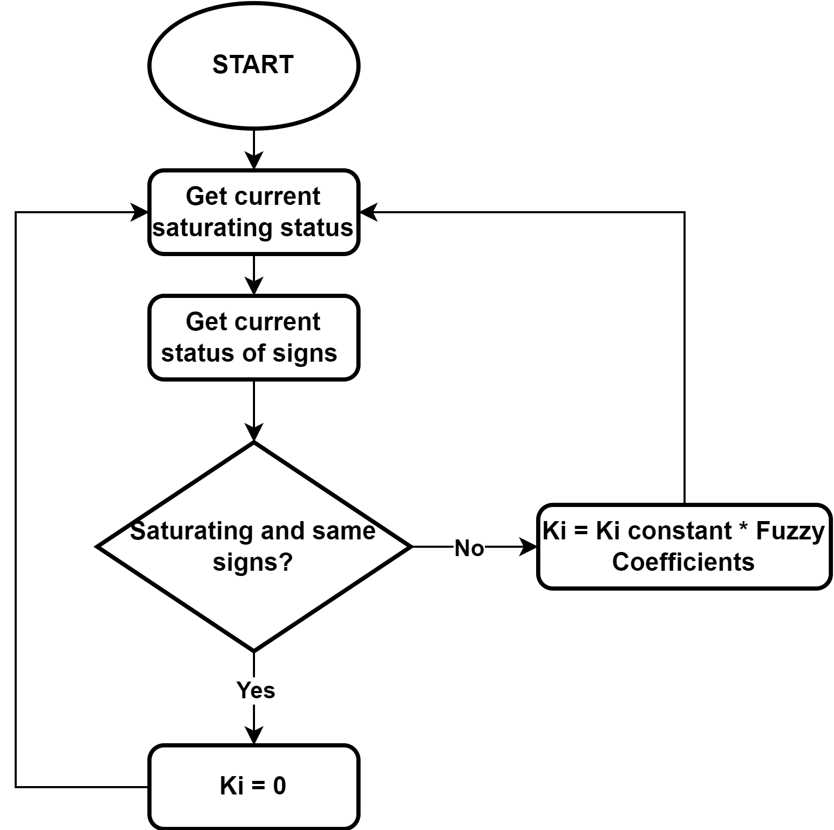
x. PID CONTROLLER FLOWCHART

Slide 16
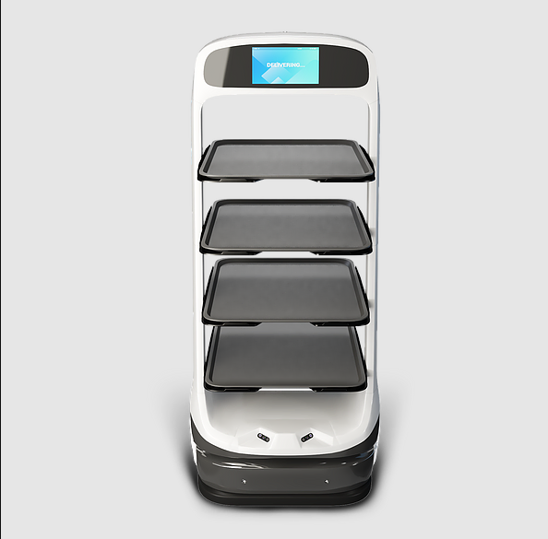
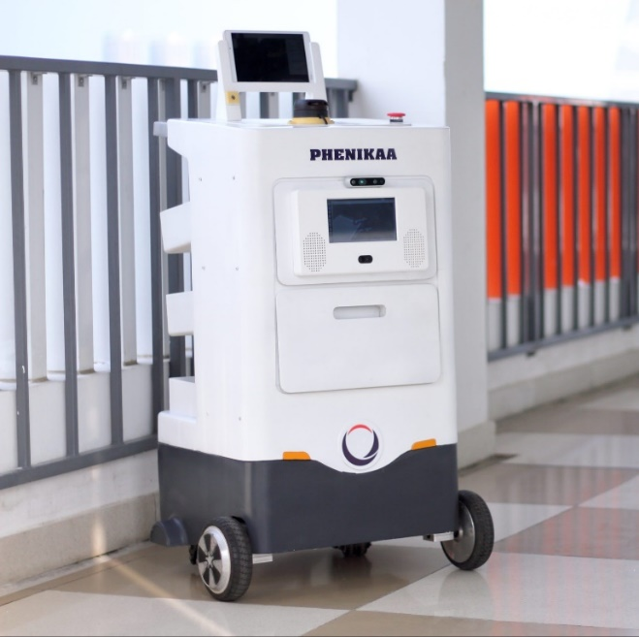
1. INTRODUCTION
Matradee Robot
Phenikaa-X delivery Robot

Slide 17
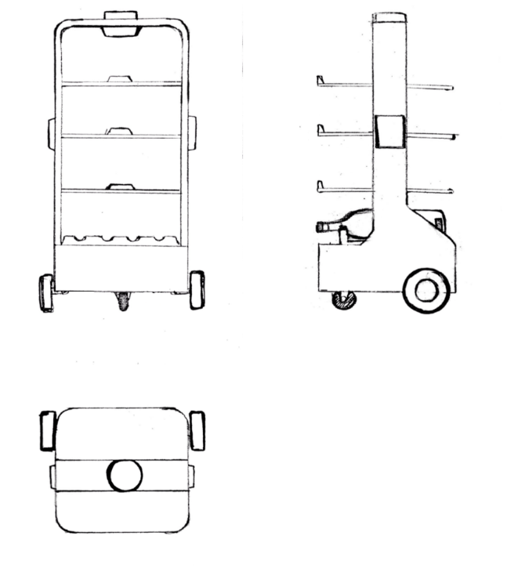
2. DESIGN IDEA
Design purpose:
+ Robot can self-navigate to the desired goal and avoid obstacles.
+ Robot can interact with customer via screen and speaker.
Specification:
+ Sensor: LiDAR, Ultrasonic sensor, IMU
+ Navigation method: SLAM
+ Body weight: 7 kg
+ Maximum load weight: 15 kg
+ Speed: 0.5 m/s
+ Power: 54 W
2D design

Slide 18
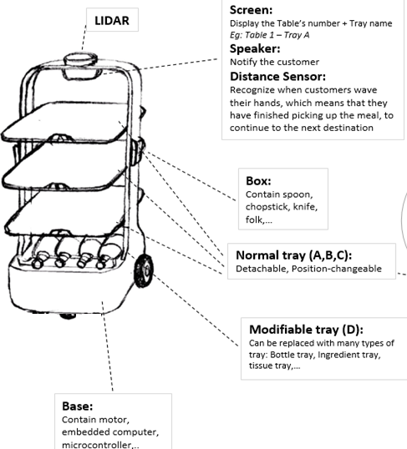
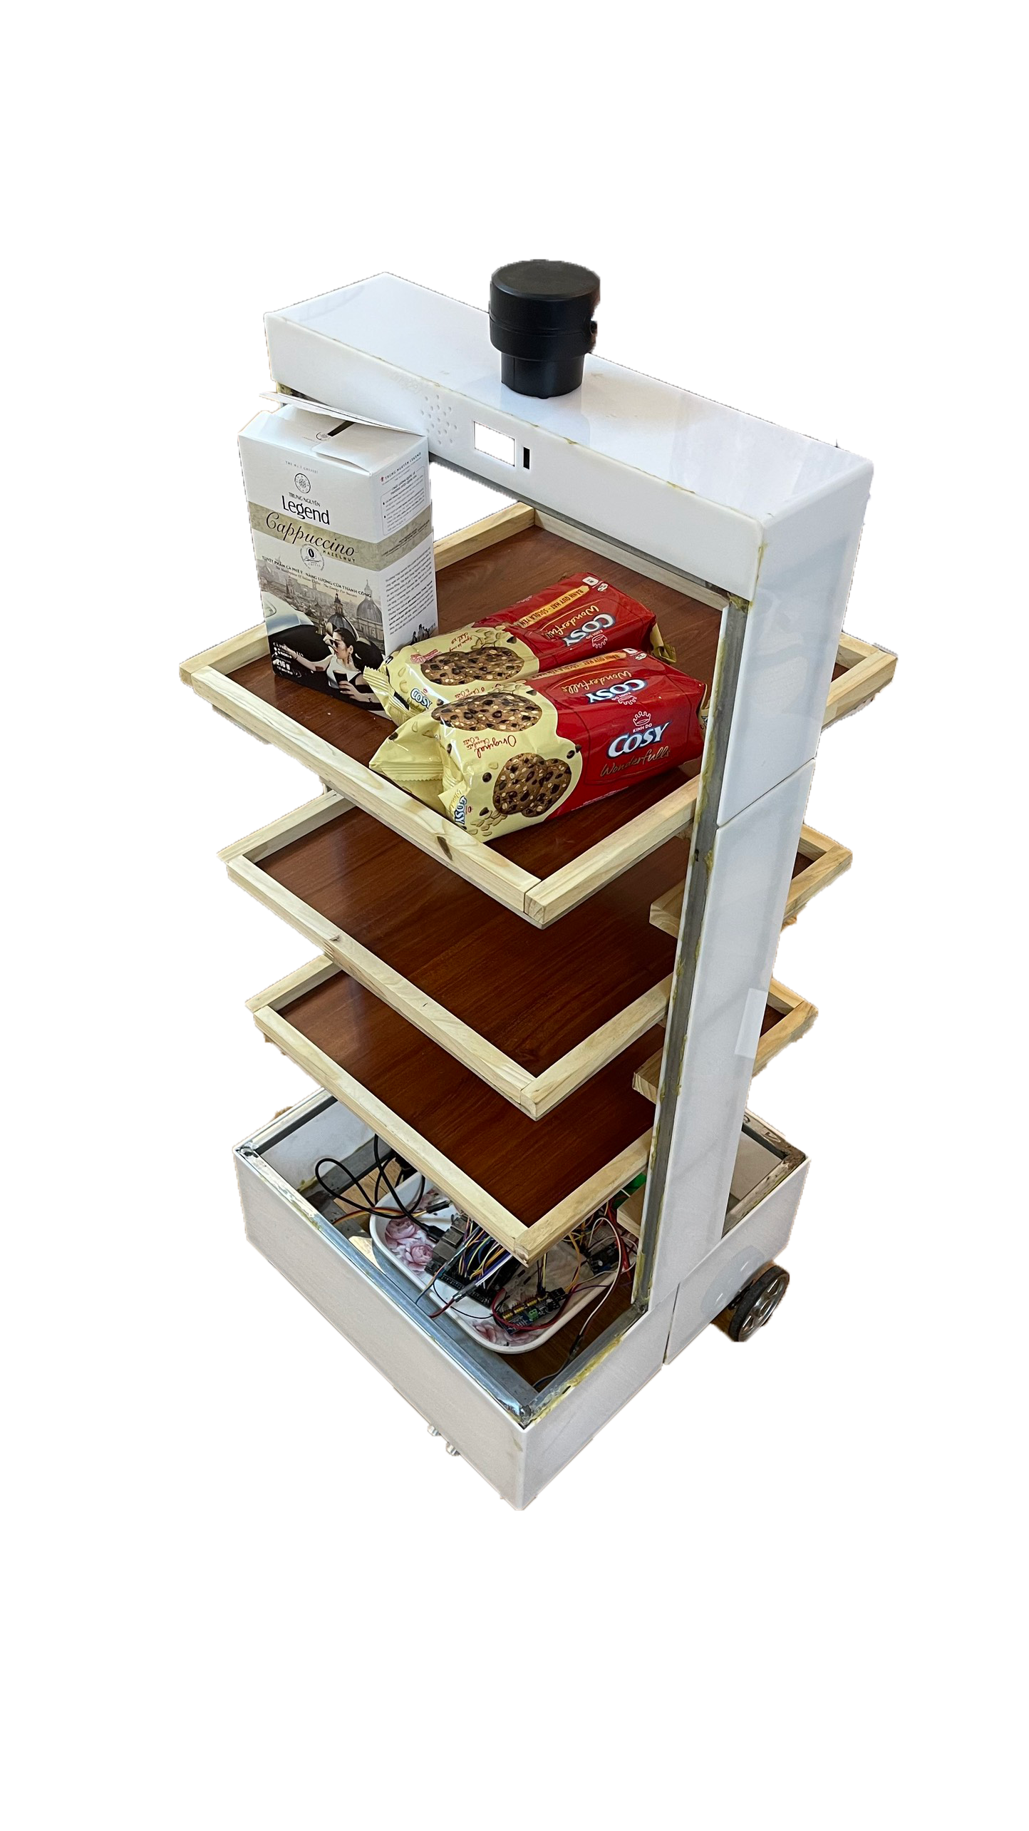
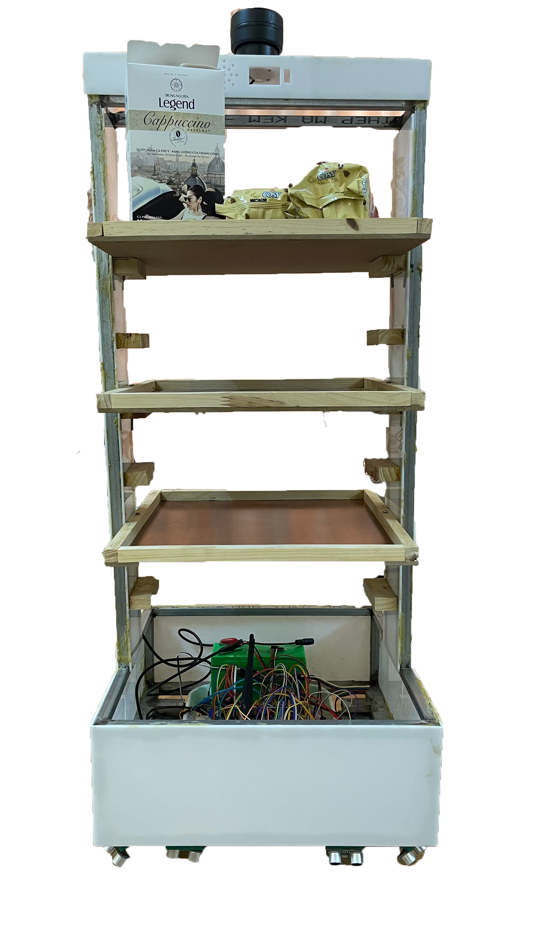
2. DESIGN IDEA

Slide 19
THANK YOU !

